Slide 1
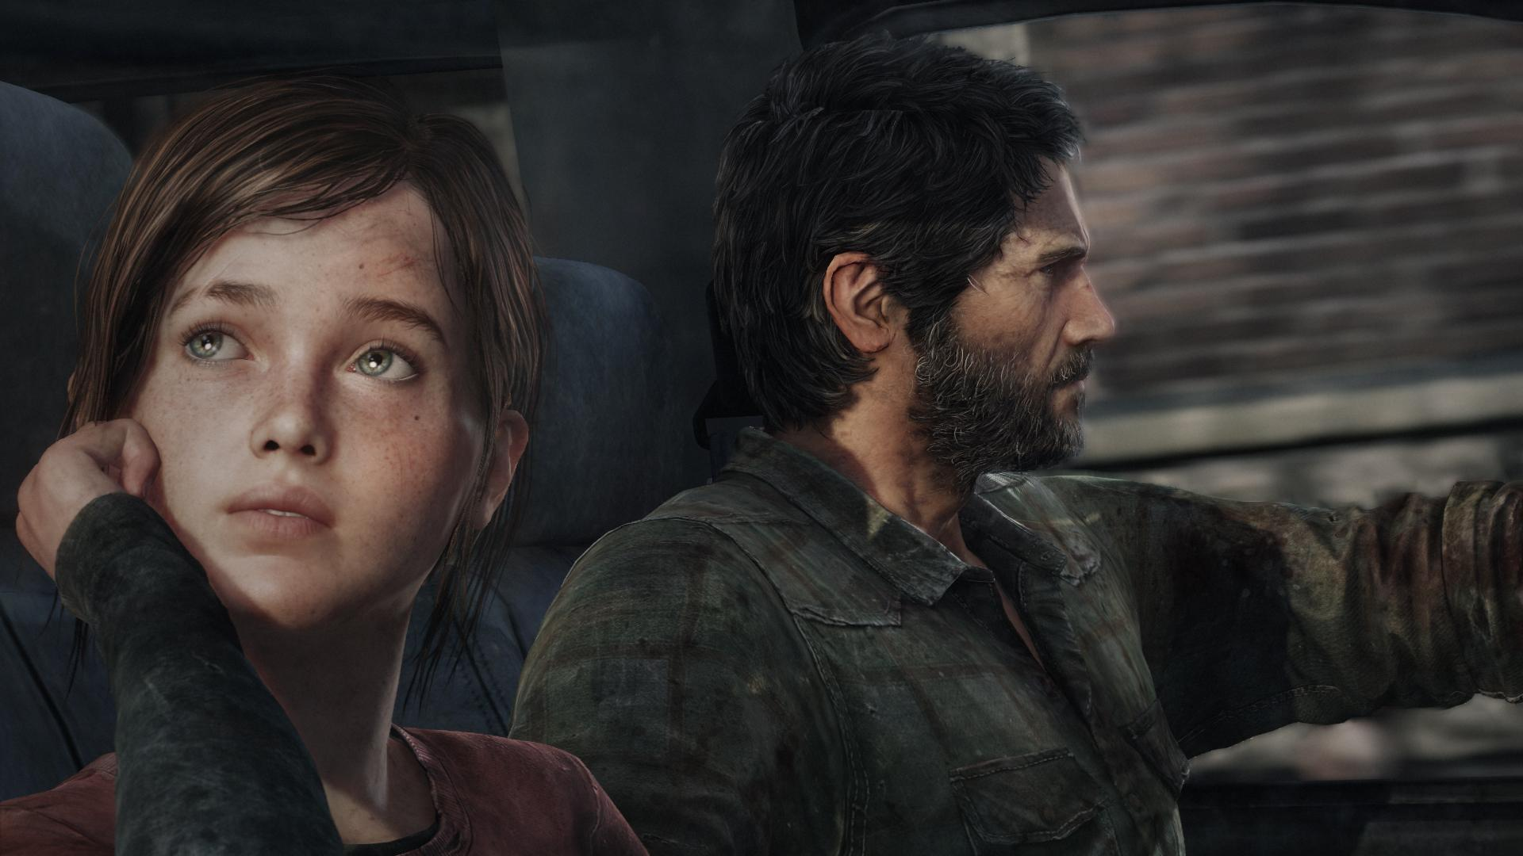
Video Games:
Art and Culture

Slide 2


High Culture Vs. Popular Culture
High Culture: forms of expression that are “intrinsically” worthwhile.
Painting, Literature, Sculpture, classical music.
Popular Culture: forms of expression enjoyed by the masses
pop music, film, television, pulp novels…and games.
Popular Culture usually thought not worthy of serious scholarship.

Slide 3

Pop Culture (studies) Matter(s)
Artists challenged the validity of Pop Culture (Andy Warhol).
Academic theorists supported them:
Marshall McLuhan, Stuart Hall, Noam Chomsky
Cultural studies often fixated on the idea of media images in relation to power—representations of race, gender, and class—and how these boundaries are reinforced or challenged.
Pop Art movement blurred the boundary between high and low culture.

Slide 4




Everything is “text”
Eventually academia came around to acknowledging (via semiotics and visual rhetoric) that everything is a “text” (cereal boxes, clothing, commercials, etc) and can be read/interpreted so that all may learn.

Slide 5
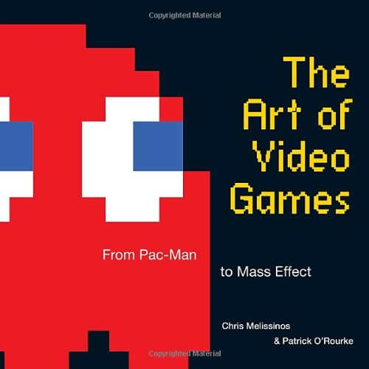
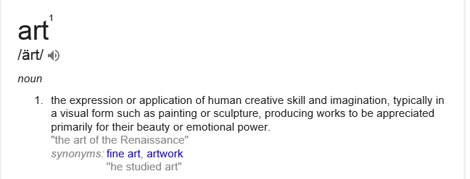
So, Are Video Games Art?
Using the standard websters/google definition, of course they are: they combine all the arts—music, drawing, writing—heck, even some consider programing an “art.”
But this is too easy.
Let’s come back to this question….

Slide 6
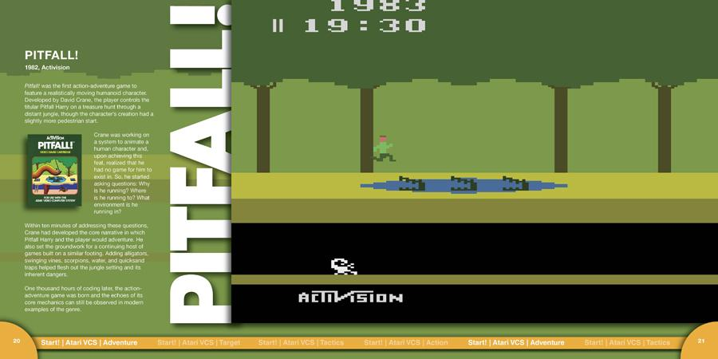
The NEA says “Yes! They are art!”
The US federal government, by way of the National Endowment for the Arts (NEA), now considers video games a form of art, making a true step toward recognition for the oft under-recognized
The category which was formerly known as The Arts on Radio and Television is now called The Arts in Media and will include all art submissions for television, film, and radio—as before—but has been expanded to include interactive technologies and media delivered by satellite or internet.
It's Official: Video Games Are Art | Fast Company | Business + Innovation

Slide 7
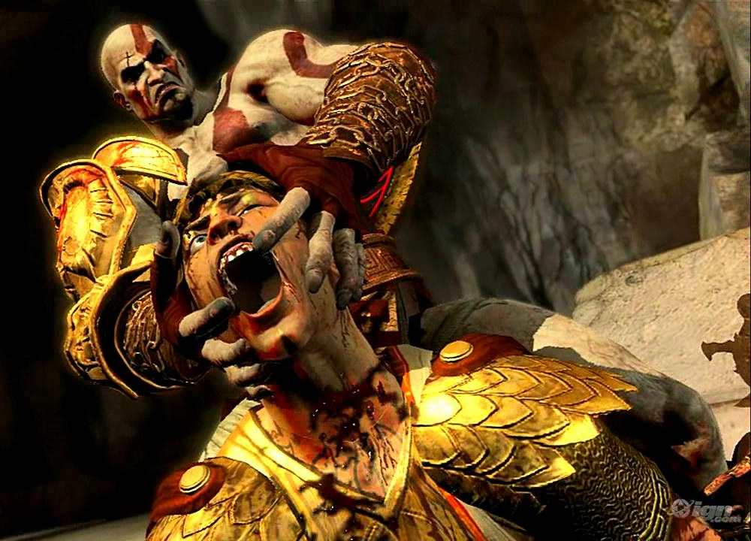
The Supreme Court Says “yes!”
Video games are art, and they deserve the exact same First Amendment protections as books, comics, plays and all the rest, the U.S. Supreme Court said in June 2011 in a ruling about the sale of violent video games in California.
Supreme Court sees video games as art - CNN.com

Slide 8

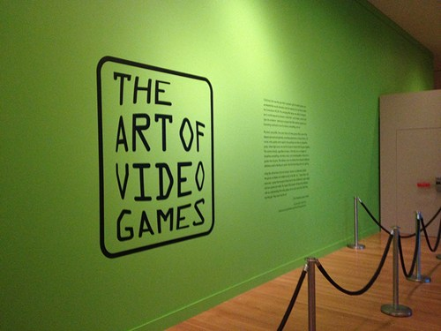
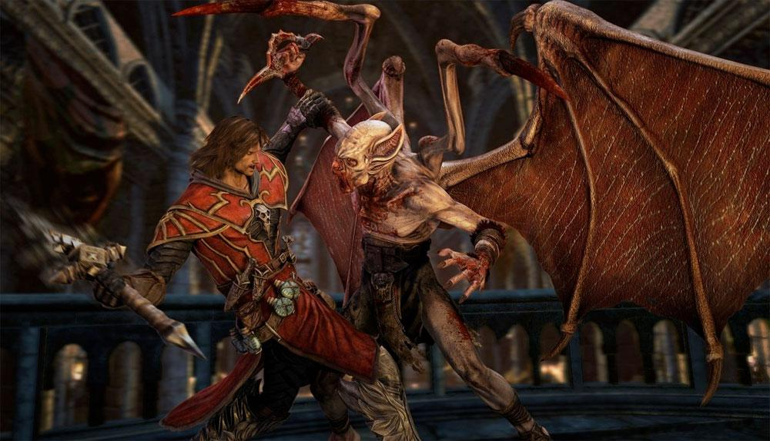
The Smithsonian Museum says “yes!”
The Smithsonian featured an exhibition, called "The Art of Video Games," from Mar. to Sept 2012.
Exhibitions: The Art of Video Games / American Art

Slide 9
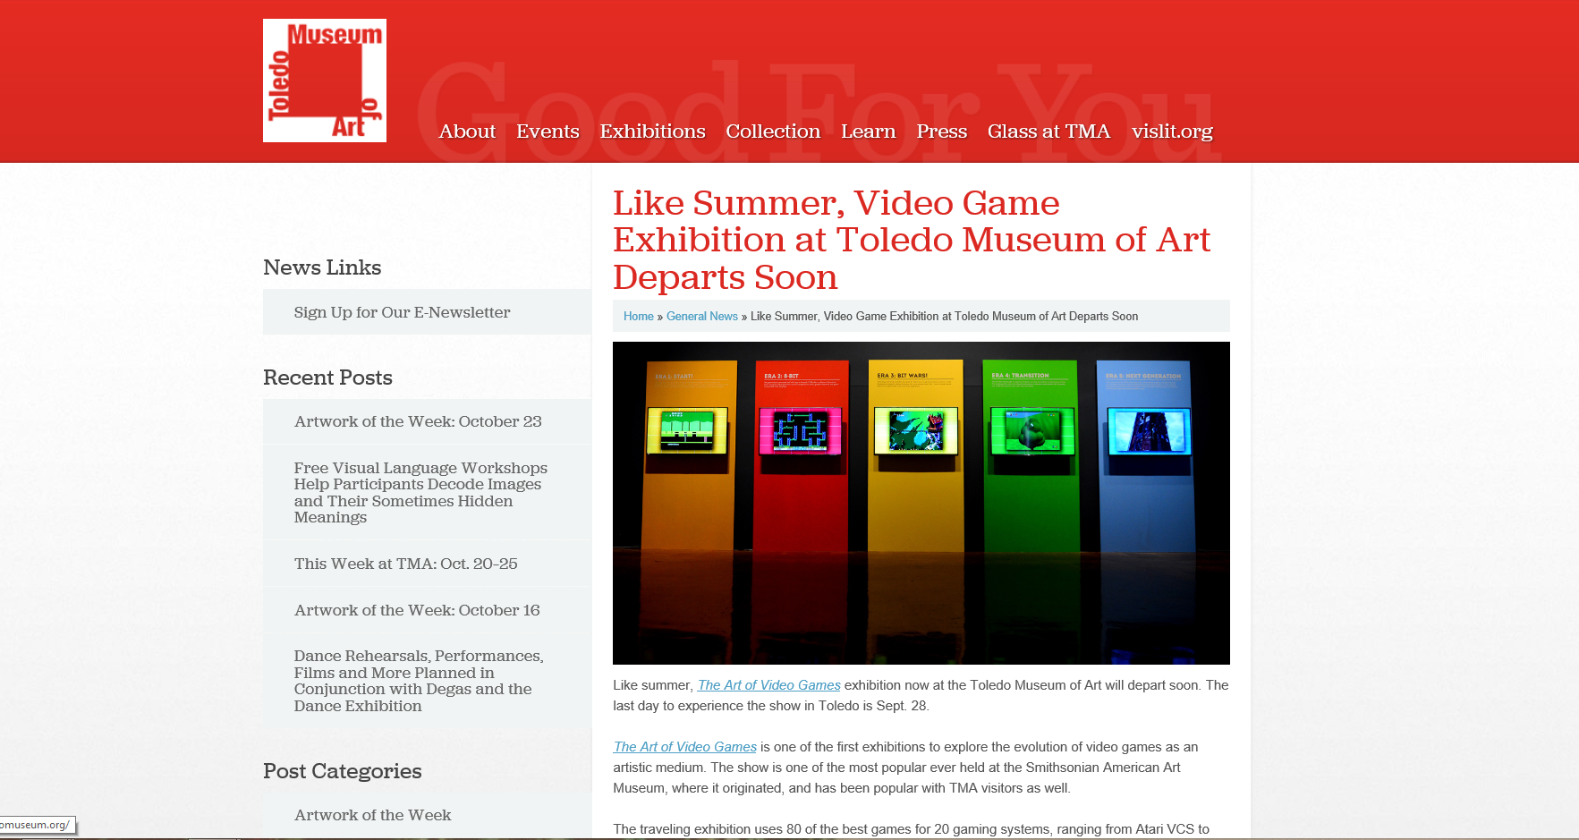
Other museums have followed suit and had their own “art of video games” exhibitions—this photo is taken from the Toledo Museum of Art, 2014.

Slide 10
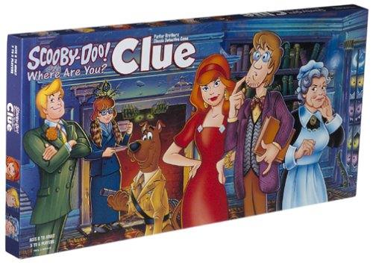

But let’s really consider this:
The video game community thinks games are art.
Various institutions think games are art.
But to many games are not art: they are just this thing that people play as they would Clue, Chess, or Horseshoes.
They say: “It's a game, not an artform”
BTW: There is some validity to this position, as short-sighted as it is…

Slide 11

Roger Ebert gets the discussion going
After provocation from a few sources, famed film critic Roger Ebert famously published a blog post in 2010 called VIDEO GAMES CAN NEVER BE ART (all caps his)—it was the most widely responded to blog post of his career. In it, Ebert intelligently and humorously lays down his opinion. It’s a good read.
Video games can never be art | Roger Ebert's Journal | Roger Ebert

Slide 12
Ebert writes: “How do I know this? How many games have I played? I know it by the definition of the vast majority of games. They tend to involve (1) point and shoot in many variations and plotlines, (2) treasure or scavenger hunts, as in "Myst," and (3) player control of the outcome. I don't think these attributes have much to do with art; they have more in common with sports.”
“I believe art is created by an artist. If you change it, you become the artist...Art seeks to lead you to an inevitable conclusion, not a smorgasbord of choices.”
And his checkmate: “No one in or out of the field has ever been able to cite a game worthy of comparison with the great filmmakers, novelists and poets.”
He says Braid has prose “like a wordy fortune cookie” and Flower’s main theme about a balance of ecological existence is as simplified as a Hallmark Greeting Card—ouch!

Slide 13
But let’s really consider this (again):
Of course there are many flaws with Ebert’s argument which is largely based on the whole “interactivity” of VG’s.
Is not the creative design of what is or is not interactive in a given medium an artistic expression - telling what someone can or can not do within the form itself while presenting them still an expression of creativity and imagination?
Where is it written that interacting with something automatically disqualifies it from being art? Especially when "art" is a relative, ever-re-defining term in the first place?
Should we not judge relative to one's own medium instead of compared to others?

Slide 14
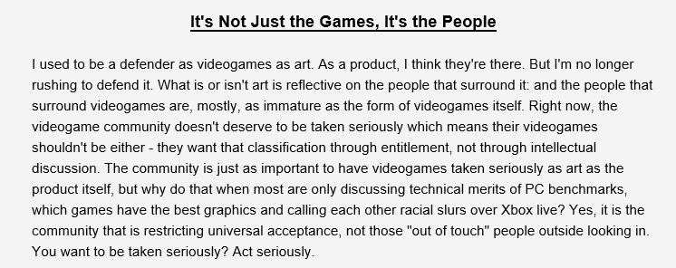
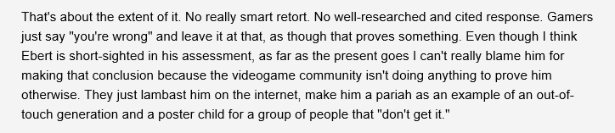
But the real problem is VG Culture…
Put simply: Video games will progress as a medium and be taken seriously when the culture itself doesn’t shout down, dox, or death threaten its critics/community—plain and simple. For example…
Videogames Aren't Art* - Digital Polyphony

Slide 15
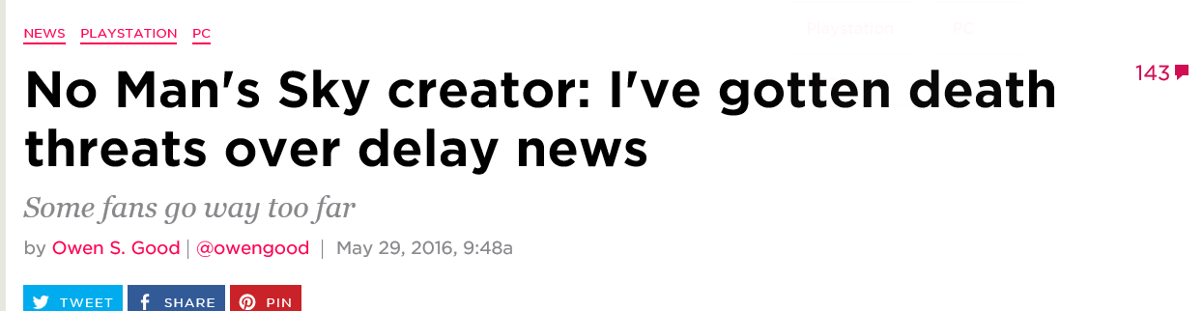
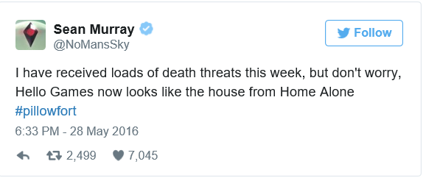



Slide 16
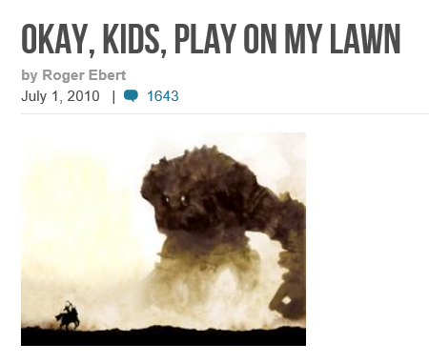
But back to Ebert…
After publishing his original argument, Ebert changes his mind a few months later and seemed more open to the potential that VGs may become sophisticated art at a later date. His major admission: “I should not have written that entry without being more familiar with the actual experience of video games.”
Again the article is an interesting read.
Okay, kids, play on my lawn | Roger Ebert's Journal | Roger Ebert

Slide 17

Destructoid - Why comparing Metroid Prime to Citizen Kane is ludicrous
Although many gamers feel games have achieved high art (ie: Bioshock, Portal, The Last of Us), some (see above link) feel Metroid Prime is not that specific game.
In 2009, Michael Thomsen from IGN wrote a lengthy essay passionately claiming that Metroid Prime is the Citizen Kane of games. He even discussed this viewpoint on ABC news.

Slide 18
http://ca.askmen.com/top_10/videogame/top-10-video-games-that-approach-art.html
#10: Rez HD (Xbox 360)
#9: FF7 (PS1)
#8: Flower (PS1)
#7: Portal (various)
#6: Braid (Xbox Live)
#5: Bioshock (Xbox 360)
#4: Grim Fandango (Windows)
#3:Okami (PS2, Wii)
#2: MGS: 4 (PS3)
#1: Shadow of the Colossus (PS2)
Askmen.com may not be a credible source for video game criticism; however, their “top 10 games that approach art” list does have merit (2010). Do you agree with these selections?
Recent adds could be GTAV, Journey, and Limbo.
Let’s discuss indie Vs AAA production in the gaming industry….

Slide 19
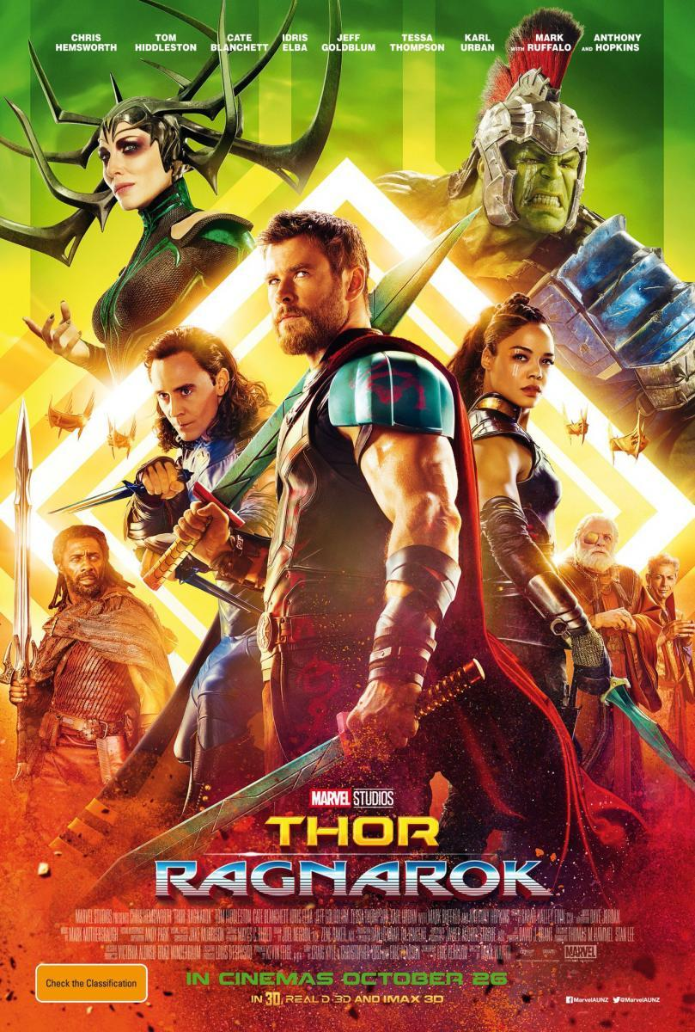
The Human Condition
Most video games are about action, fantasy or killing (be it zombies, soldiers, or goomas).
These compare nicely to the ‘popcorn movies’ of the summer (ie: MARVEL).
However, other mediums—novels, film, music, painting—have their fair share of works about The Human Condition: "the characteristics, key events, and situations which compose the essentials of human existence, such as birth, growth, emotionality, aspiration, conflict, and mortality.”
I’d also add love to this list!
Are their any video games that tackle these themes in a meaningful way?

Slide 20

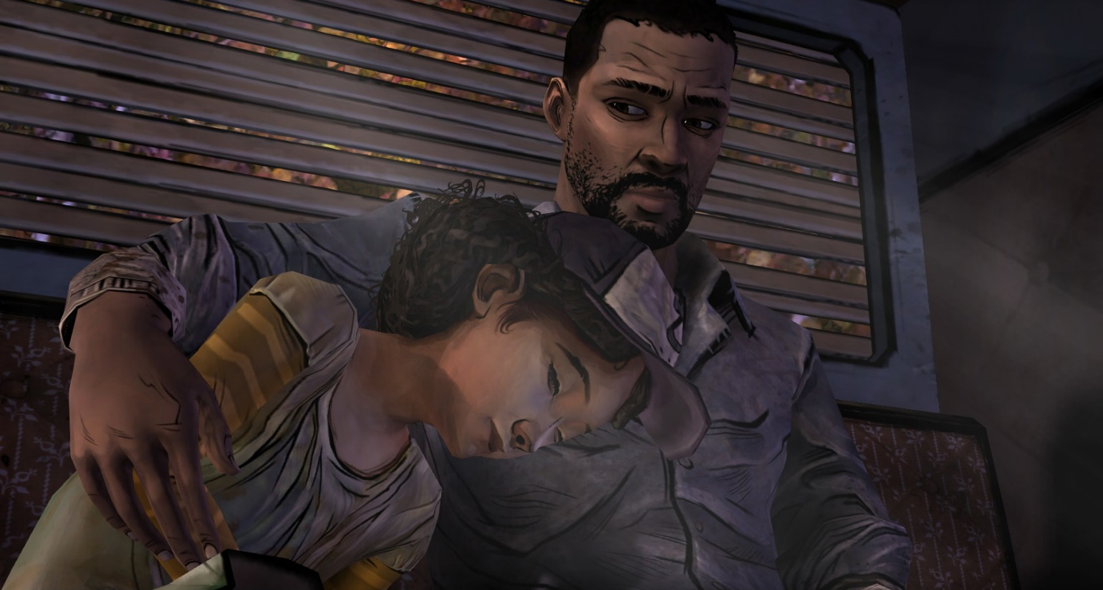
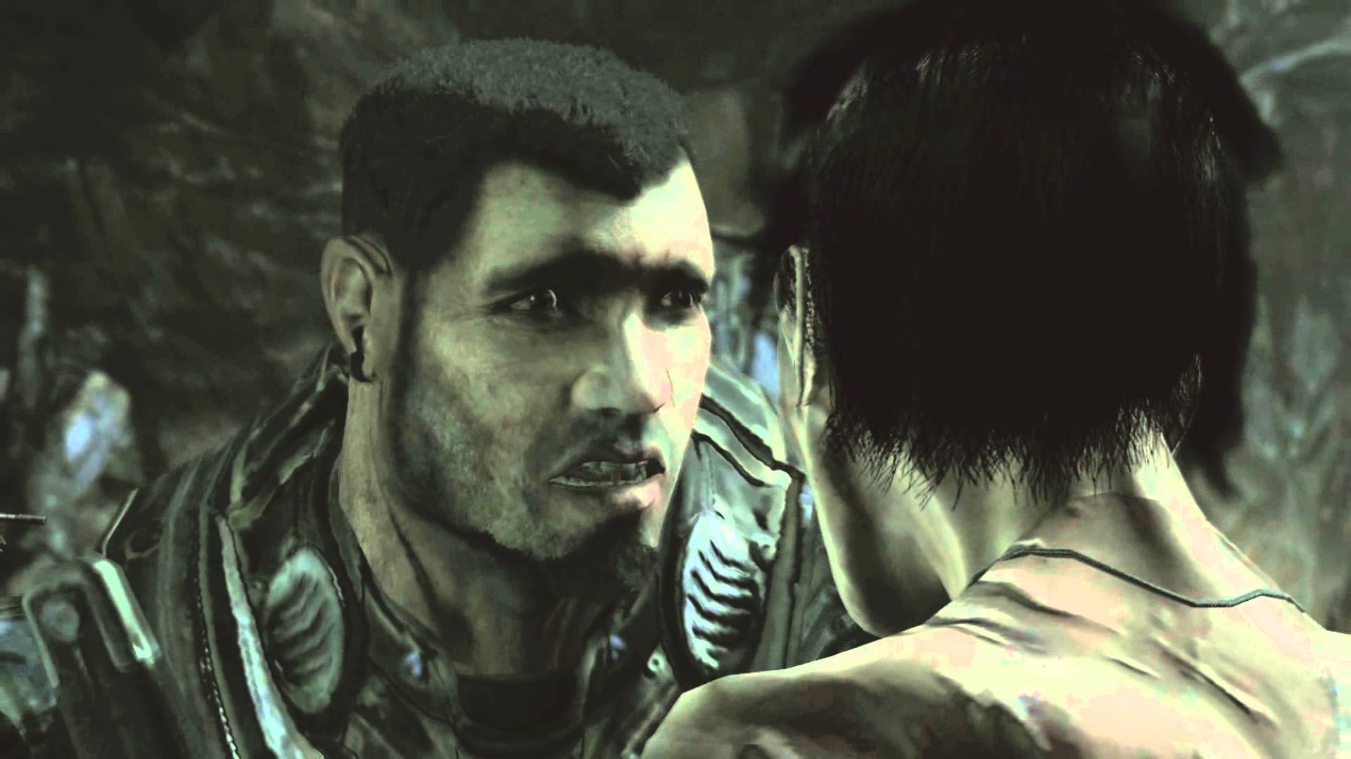
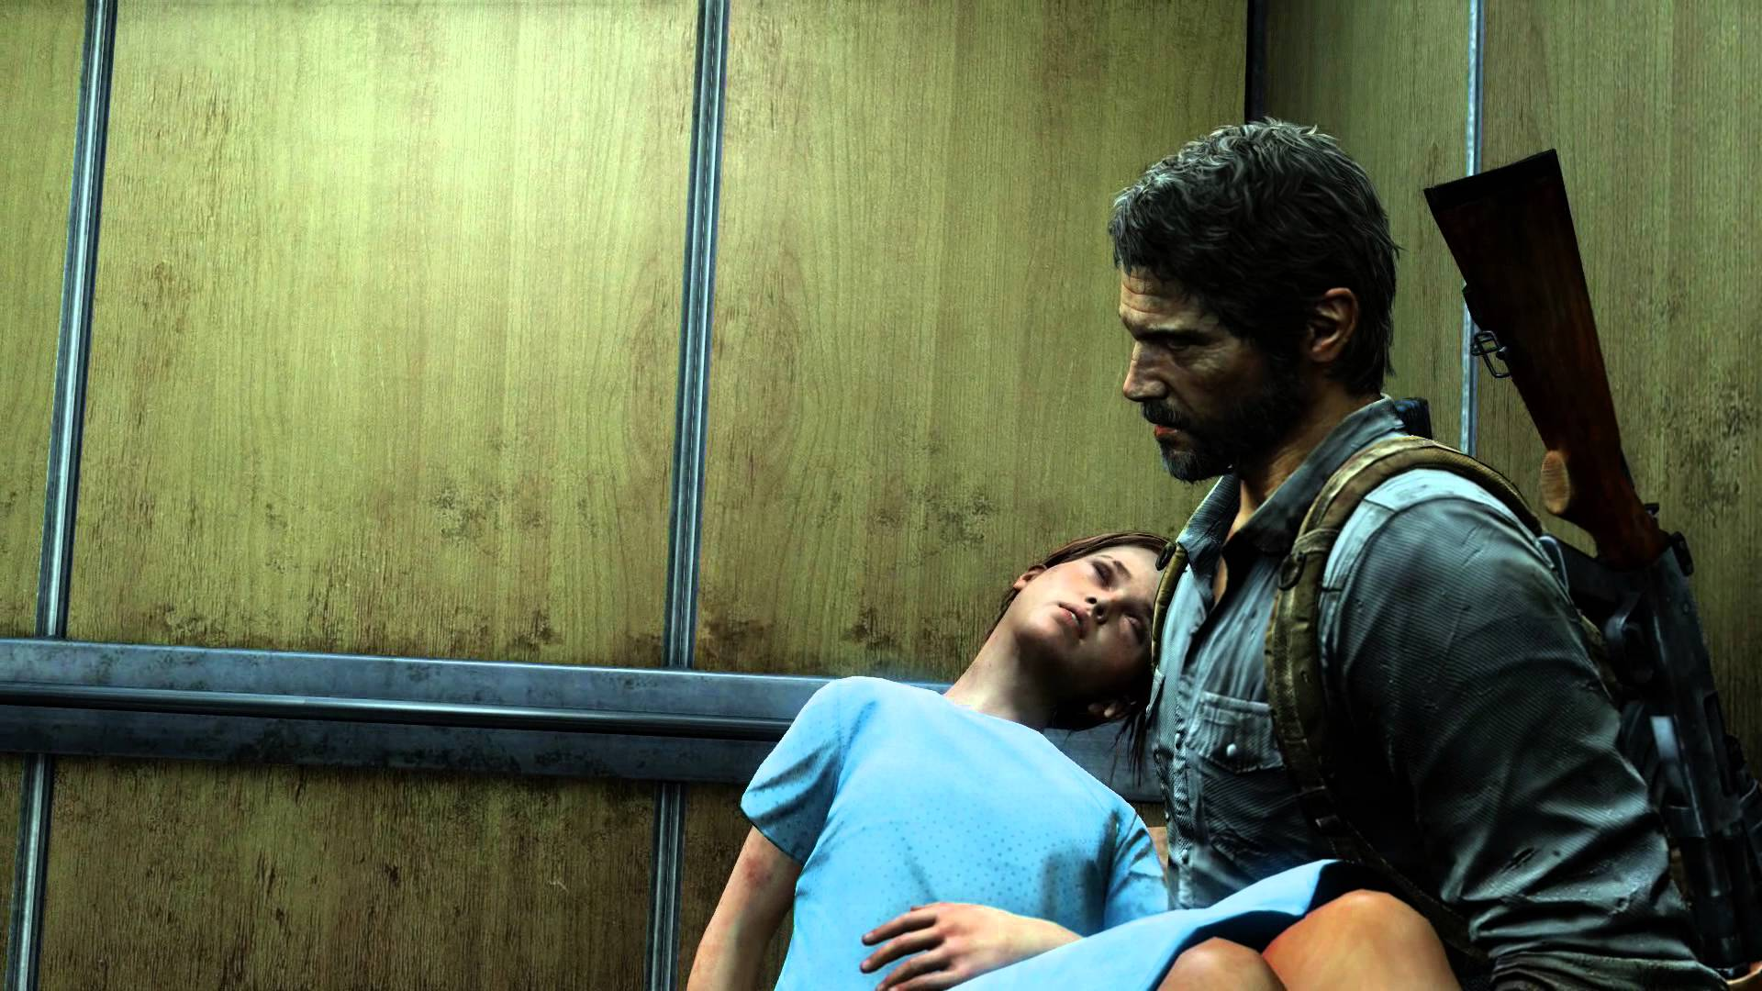

Slide 21
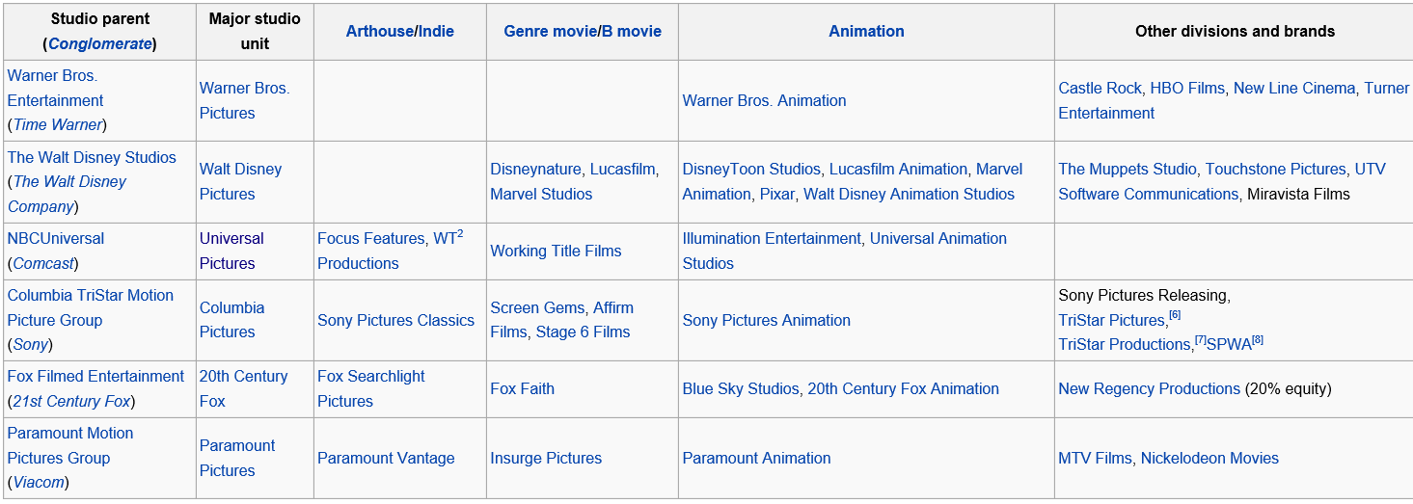
Indie Vs AAA in Film
Big film studios often have a balance of indie and blockbuster titles: the parent company releases the popular stuff, while another “brand” (owned by the studio) releases the more indie flicks.

Slide 22

Spotlight: Best Picture of 2015. Budget was 20 million dollars. Box Office was 88 Million—NOT a blockbuster—in fact a FAILURE by revenue standards, but an “important, serious” film nonetheless
Spotlight was released and distributed by Universal Pictures
Universal also released Jurassic World and Fast and Furious 7.

Slide 23

True Indie Films
Filmmakers still make indie films (shown at film festivals, released via streaming services like Vimeo).
If the filmmakers are lucky, a major studio will buy the film rights and release it for a share of the profits.
Paranormal Activity was made independently for $11,000 and grossed $194 million. It was distributed by Universal Pictures.

Slide 24
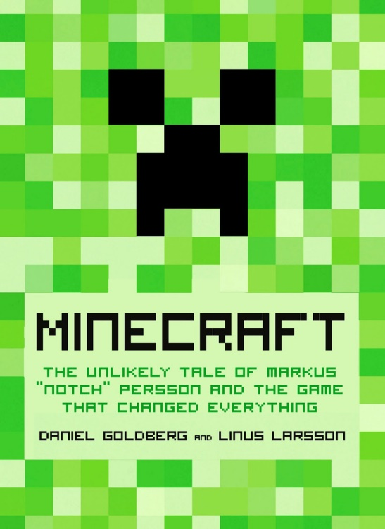
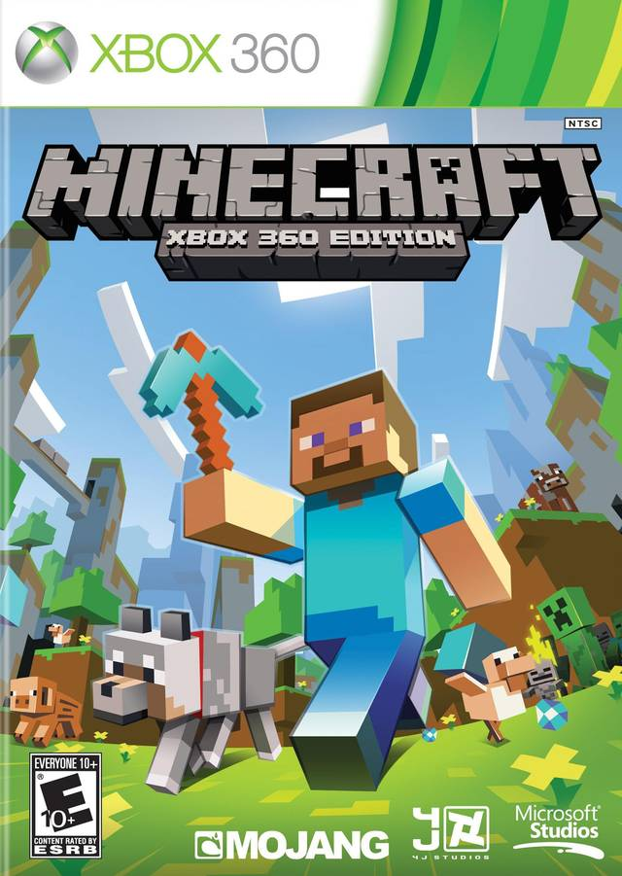
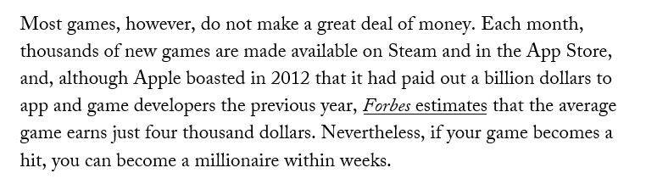
Minecraft
There are very few independent blockbuster games. Minecraft is the rare exception—conceived by Markus Persson and made with two others (at first).
Made TONS of money on its own.
Eventually sold to Microsoft in 2014 for 2.5 billion dollars.
The Guilt of the Video-Game Millionaires - The New Yorker

Slide 25
Indie Games Cont.
As in the film industry, sometimes a major studio/company will buy the publishing rights and distribute a game (for a profit); other times, a major studio might simply buy up the indie studio and the game rights all at once:
Halo: Made by Bungie (purchased by Microsoft, now indie again)
Left 4 Dead: Made by Turtle Rock Studios (purchased by Valve, now indie again)
COD: Made by Infinity Ward (purchased by EA)
Dead Space: Made by Visceral Studios (published by EA)
But for the most part, games are made within big companies with big production schedules, backed by big investors.

Slide 26

The Sad Tale of Iron Man The Video game and Secret Level
Way Back in 1998 indie studio Secret Level is purchased by Sega.
Sega buys the Iron Man property and gives it to the new studio to make—all great!
Secret Level designs what they think is a great game—it is horribly reviewed.

Slide 27
The Tale of Iron Man The Video game and Secret Level
With the critical and commercial failure of Iron Man, Sega disbanded Secret Level and absorbed a selected few to restart the studio under a new name, Sega Studios San Francisco.
The new studio didn't have the autonomy the previous studio did, with Sega directly controlling all of its ventures.
On April 2, 2010, Sega announced that Sega Studios San Francisco would be closed with the release of Iron Man 2 (which also got horrible reviews)

Slide 28
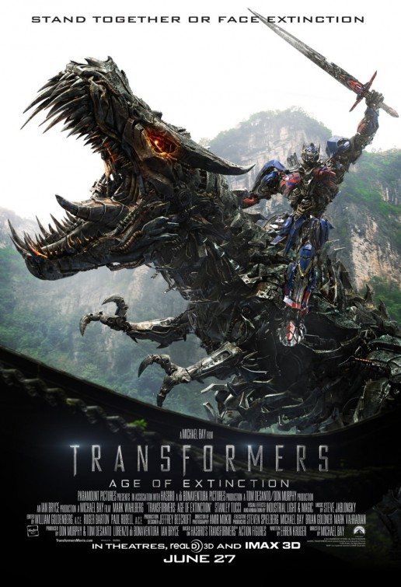

Game Designer Autonomy
The pros of working for a big company on AAA titles are obvious: job stability and money
The cons are sometimes ignored: less creative freedom, less of a connection to the overall project, less of a say in creative direction.
It’s a choice, but some designers would rather be on their own working for a smaller company on more meaningful and artistic games than churning out the same old Apps that take no risks whatsoever….
And how can big budget games take risks: games are so expensive to design that big companies/publishers want a return on investment! But how do you advance the medium artistically with this mandate? You often don’t…

Slide 29

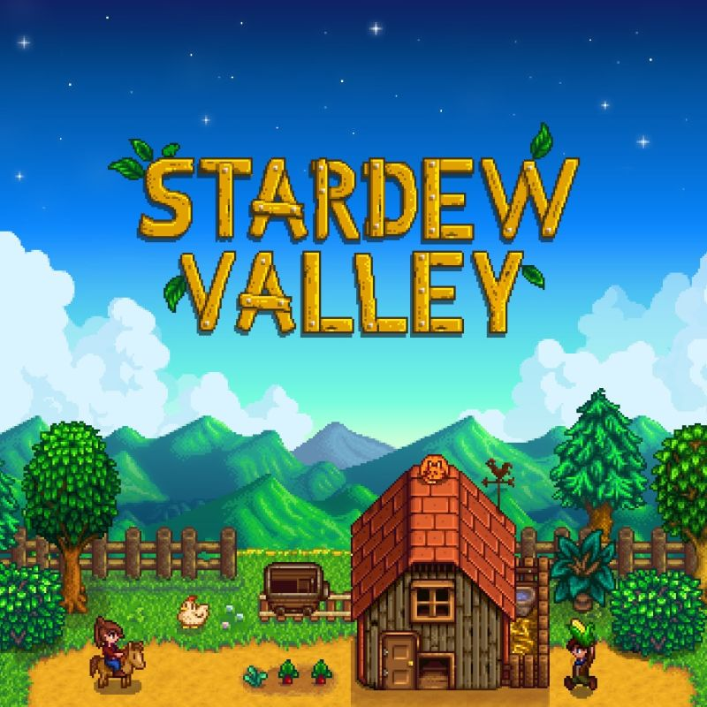
Eric Barone (AKA ConcernedApe)
Creator of Stardew Valley—an SNES Harvest Moon inspired game.
Took 4.5 years to create: did it entirely by himself—all art, music, dialogue, features—you name it.
Took major risks—a labour of love/passion project.
In the end, the game has loads of charm, has sold millions of copies, with Baron taking home well over 30 million dollars (and counting), and has been critically acclaimed.

Slide 30
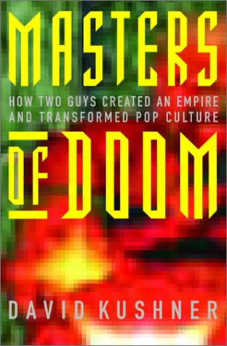
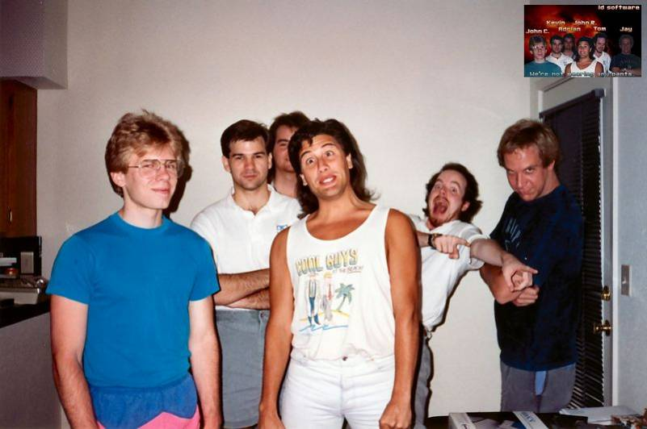
DOOM was an Indie Game?
ID software formed by 6 guys
John Romero—level design
John Carmack—game engine
Game distributed via share-ware
Downloaded by an estimated 10 million people within two years.
More copies on computers in 1995 than Windows 1995.
According to GameSpy, Doom was voted in 2004 by industry insiders to be the greatest game of all time.
Errant Signal: DOOM critique

Slide 31

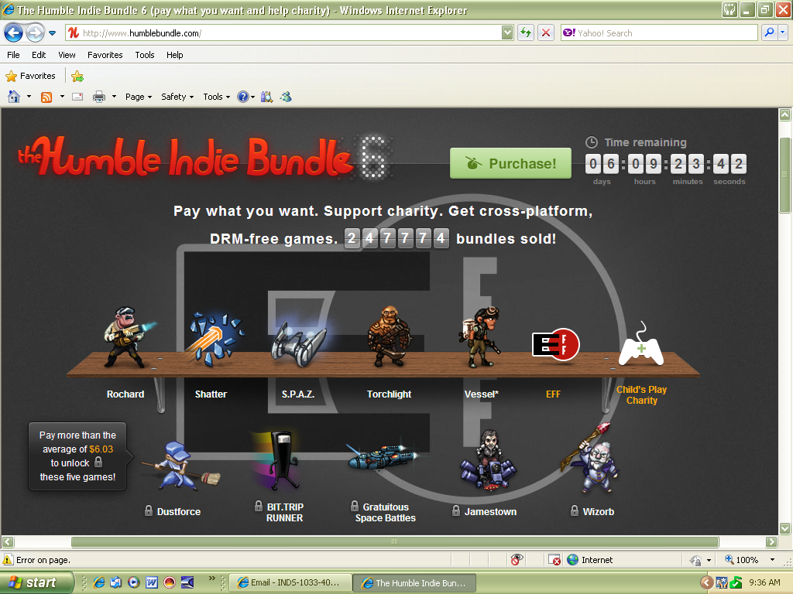

Indie Support
Kickstarter has somewhat leveled the playing field regarding development money.
Steam, XBL, the Apple Store and the internet in general have also provided indie developers with even more potential to expose their games to a reasonable audience.
And yet with all this freedom, the dominant way to get a AAA title out here is via traditional retail methods.
The question indie developers have to ask is how far they are willing to change their artistic vision to get wider exposure?

Slide 32

Jonathan Blow: Braid
Made for $200,000
Financed it himself
Critically acclaimed
Made an estimated 4million
emphasizes a need for developers to design inspiring new games using "innovative, ethical and personal art.”
YouTube - Braid Trailer

Slide 33
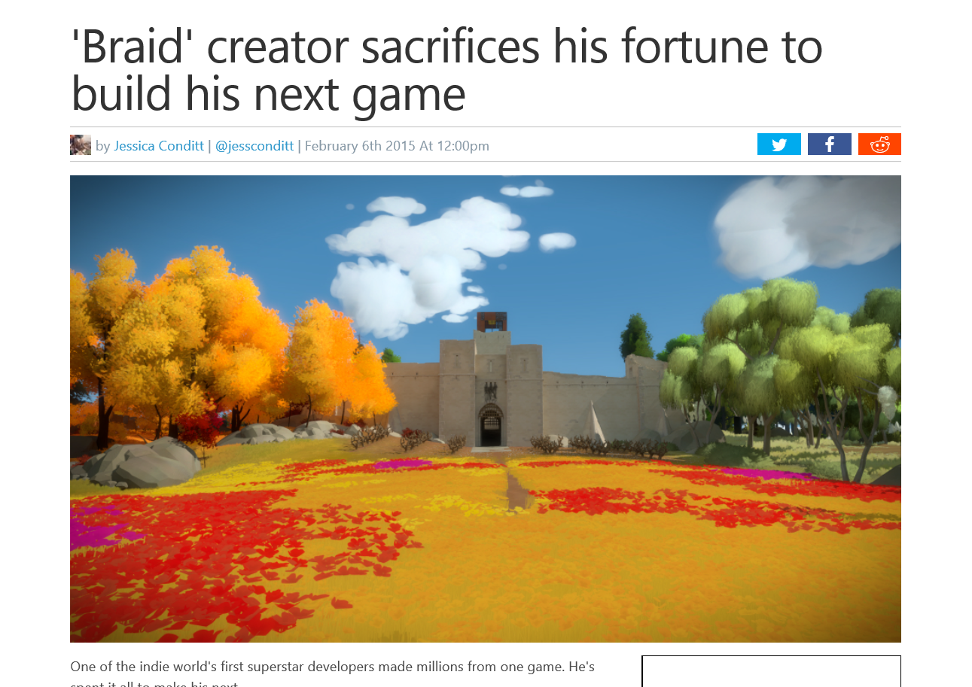
Final development costs were estimated at just under $6 million. While Blow considers The Witness as an indie game due to the lack of funding or support from a major publisher, he also feels the scope of the project by time and cost to be closer to that of what a AAA studio would produce, and represents a new type of game development in the industry.
'Braid' creator sacrifices his fortune to build his next game

Slide 34


Slide 35
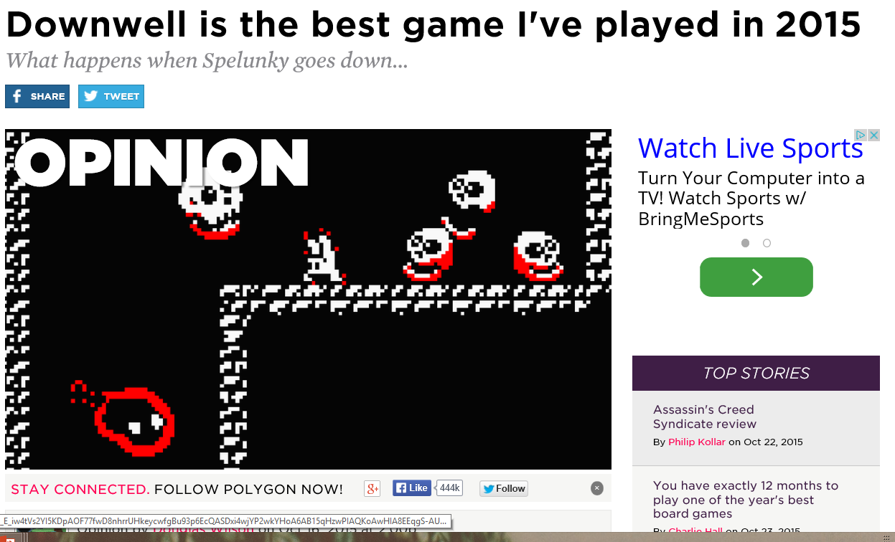

Slide 36
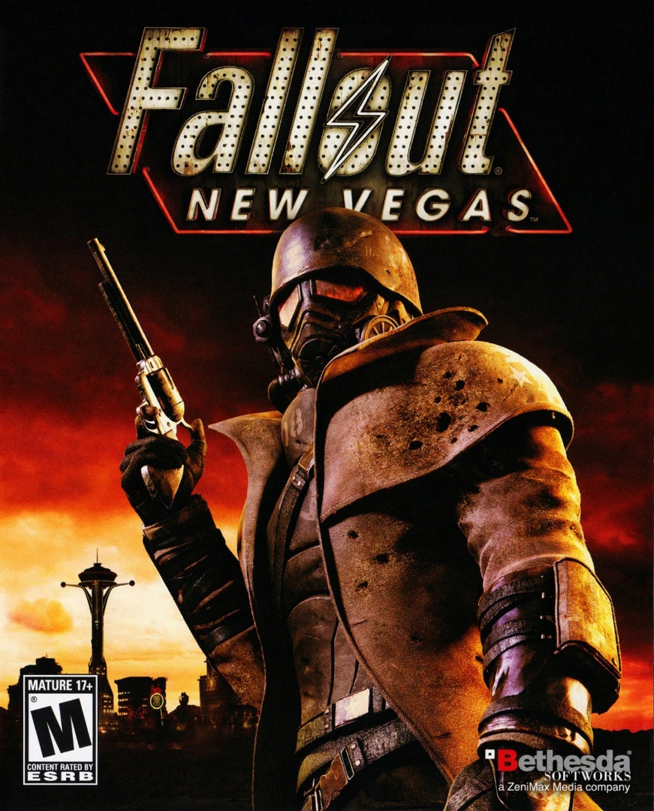
Game Reviews and “Art”
Review scores can have a major impact on the success of any given game.
Developer bonuses can also be given or taken away based on the review scores that the game receives.
For example, developer Obsidian Entertainment was going to be given a bonus if their game Fallout: New Vegas received an aggregate score of 85 or higher on Metacritic.
It got an 84 on PC/Xbox 360
It got an 83 on PS3
This failure to get an 85% cost developers $1M
Roughly $14,000 per person

Slide 37
Game Reviews and “Art”
You may not care about review scores when you buy a game, but game publishers and developers are certainly concerned with their scores:
“Typically, when you go into pitch meetings and whatnot, publishers are going to want to know your track record as far as Metacritic…When you're negotiating with the publisher for a contract, you build in bonuses for the team based on Metacritic score. So if you get above a 90, then you get X amount for a bonus. If you get below that, you don't get anything at all or get a smaller amount.” – Kim Swift, game developer

Slide 38
Game Reviews and “Art”
“Like a food company performing a taste test to find out that people basically like the saltiest, greasiest variation of anything and adjusting its product lineup accordingly, the big publishers struggled to stuff as much of those key elements as possible into every game they funded.
Multiplayer modes were suddenly tacked on late in development. More missions and weapons were added to bulk up their offering–to be created by outsource partners. Level-based games suddenly turned into open-world games… All these people wanted in the end was the best game possible–or, more precisely, the best-reviewed game possible.” – Matt Burns
Metacritic Matters: How Review Scores Hurt Video Games | Kotaku UK

Slide 39

Pre-Orders, Exclusives, and Embargoes
Pre-Orders are big in VG culture—get your copy today! We may run out! (note: they never do). Or consider perks.
Many publishers won’t give early copies of their game to reviewers in case the game gets bad reviews and pre-orders are cancelled.
Others give journalists game copies but under an embargo: a stipulation that they will not publish their review until the game’s release date (unless it’s guaranteed to be positive…). And if said journalist/publication breaks the embargo—tells the public the game sucks—they may never get pre-release games again.
Games aren’t like films—you can see a film release day and have a full review up by 2pm. Film Reviewers don’t need to suck up to studio executives.

Slide 40

Game reviewer Geoff Keighley in what has been called ‘Dorito-Gate’: gaming journalism has for a long time faced “an avalanche of complaints and suspicion about the coziness of the gaming press with the public relations wing of the companies whose games they cover.”
Lost Humanity 18: A Table of Doritos • Eurogamer.net

Slide 41
What Does This All Mean????
Video Game won’t progress as an artform if their entire reason to exist is to be as commercially appealing and financially successful as possible—a mainstream enterprise that takes zero risk.
Video Games won’t progress as an artform if critics and ‘journalists’ aren’t allowed to express valid critical opinions about weaker games: not everything can be good, and ‘good’ art learns from its mistakes.
Video Games won’t progress as an artform until the medium itself “matures” (via different subjects) as well as its “audience” (via constructive critical arguments as opposed to death threats and personal attacks).
“Everyone has a nice easy ride if the review scores stay decent and the content of the games are never challenged. Websites get their exclusives. Ad revenue keeps rolling in. The information is controlled. Everyone stays friendly. It's a steady flow of Mountain Dew pouring from the hills of the money men, down through the fingers of the weary journos, down into your mouths. At some point you will have to stop drinking that stuff and demand something better.”

Slide 42

Public Perception of VGs
Gaming is both accepted by mainstream culture and rejected by it—ambivalence!
At worst, “games are considered unsophisticated in their form, problematic in their content, the cause of health problems from obesity to addiction to aggression”(162).
At best…well, to be continued next week.

Slide 43
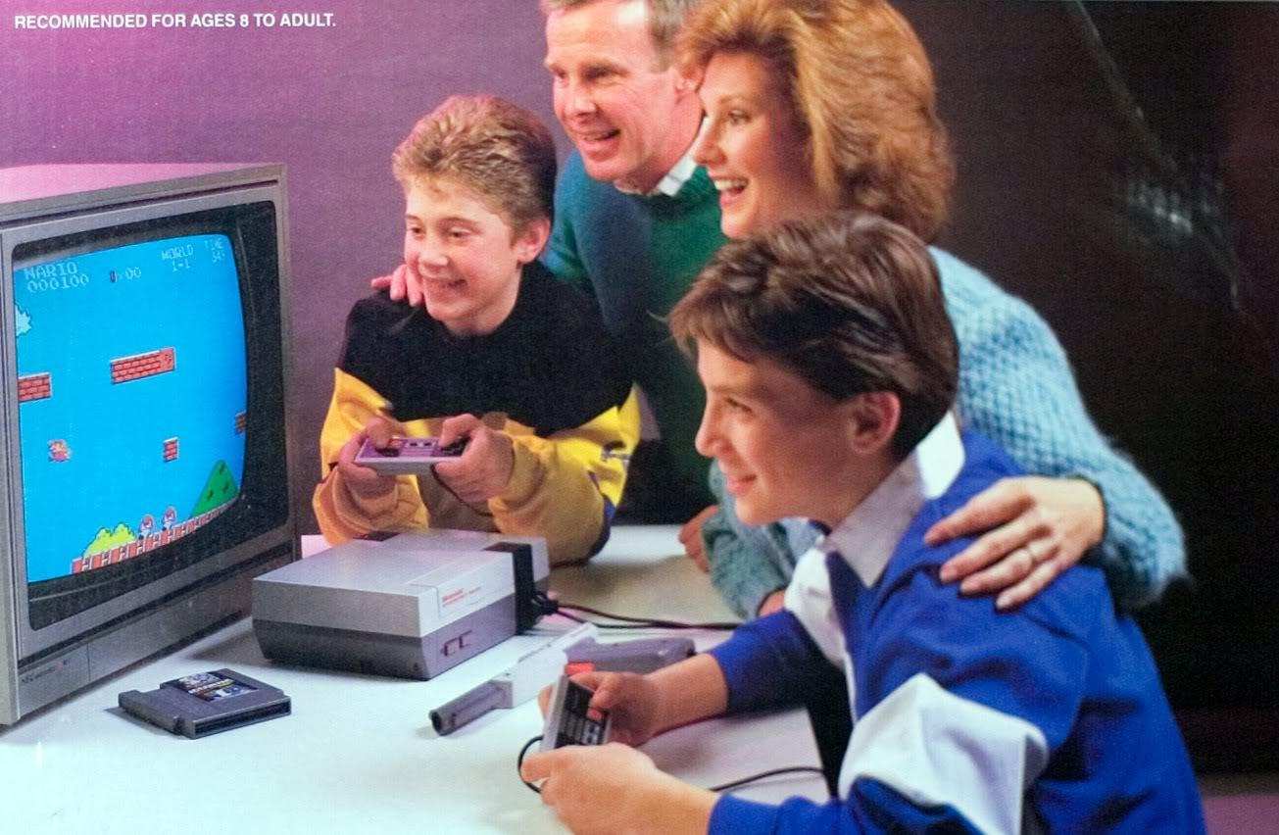
Early Marketing
Given video games’ public perception as largely negative, the industry originally adapted to finding ways to market itself as non-threatening.
Atari, Nintendo and the PC where seen as tools that could bring families together and be used to do one’s homework (well, just the PC for the last one)

Slide 44

Subculture to Mass Culture
Other campaigns have seen the industry embrace its edginess.
“The Sega Scream” for example
Game Gear Super Sonic Sports Pack commercial (US) - YouTube

Slide 45


Slide 46

Subculture to Mass Culture
In 2001, with the release of the Xbox, Gamecube and Playstation 2, the gaming industry finally targeted the general public as opposed to already established gamers.
Games were no longer for “geeks” and “children”—they were a legitimate past time for everyone.
Advertising has continued to show playing games as part of “normality”: no more aggressive male teens in darkened rooms!

Slide 47
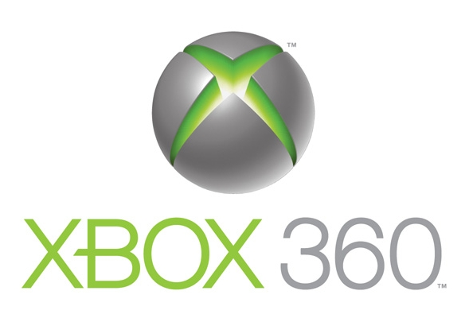


XBOX 360
Slogan: “Jump in”
Launch ads: A water balloon fight and jump rope freestyling.
Verdict: fun, inclusive, non-threatening.
YouTube - Xbox 360 Commercial - Balloons
YouTube - Jump In Xbox 360

Slide 48
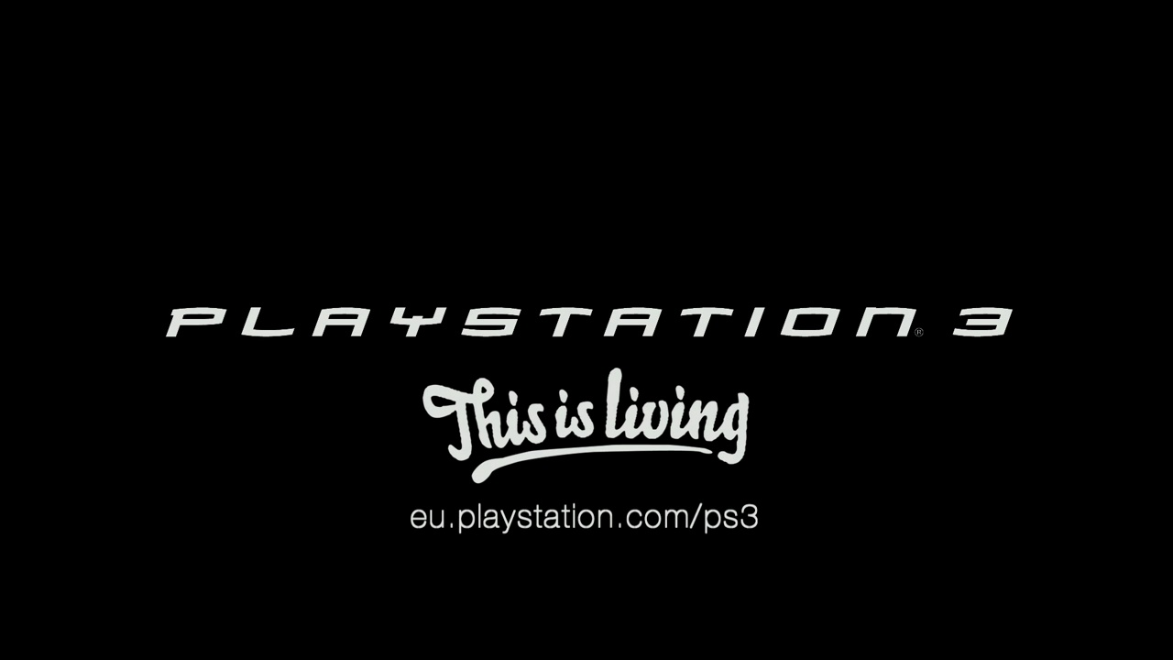


PS3
PS3
Slogan: “Play B3yond” and “This is Living.”
Launch ads: freaky people and effects.
Verdict: weird, ominous, threatening.
This Is Living
YouTube - PlayStation 3 Rubiks Commercial - hi-res version

Slide 49


Wii
Slogan: “Wii Would Like To Play”
Launch ads: all people of all ages and races having fun.
Verdict: fun, inclusive, non-threatening.
YouTube - Wii Ad - Cool!

Slide 50

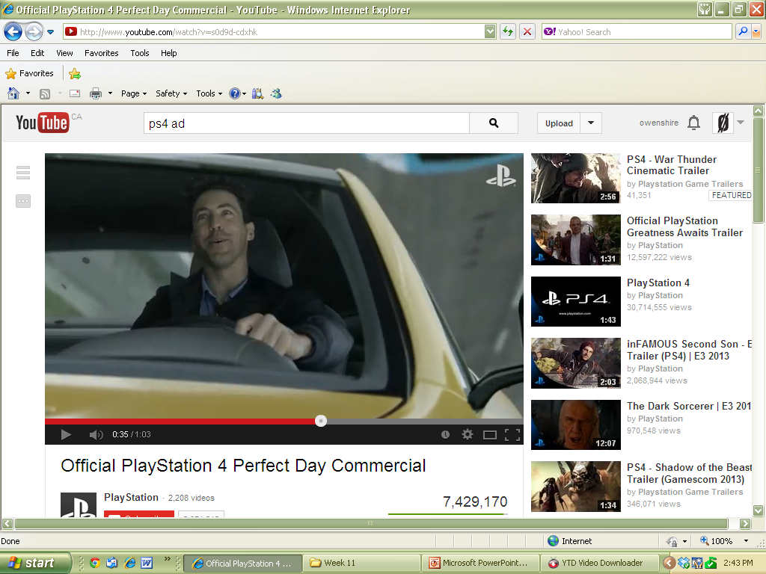
PS4 and XBOX ONE
Again, no kids: only adults in commercials
Emphasis on action and escapism
Nice gender angle in the XBOX ad.
His and Hers
Perfect Day PS4 Commercial

Slide 51
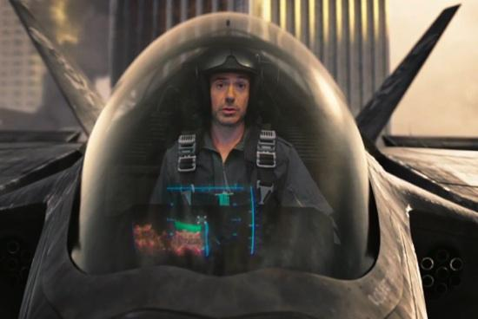
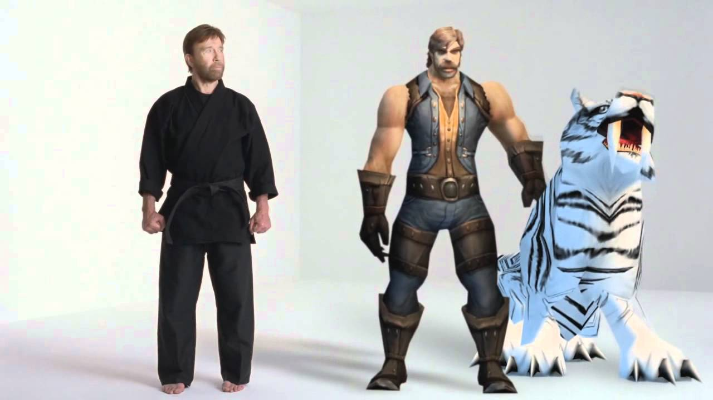
Game Commercials and Celebrities

Slide 52
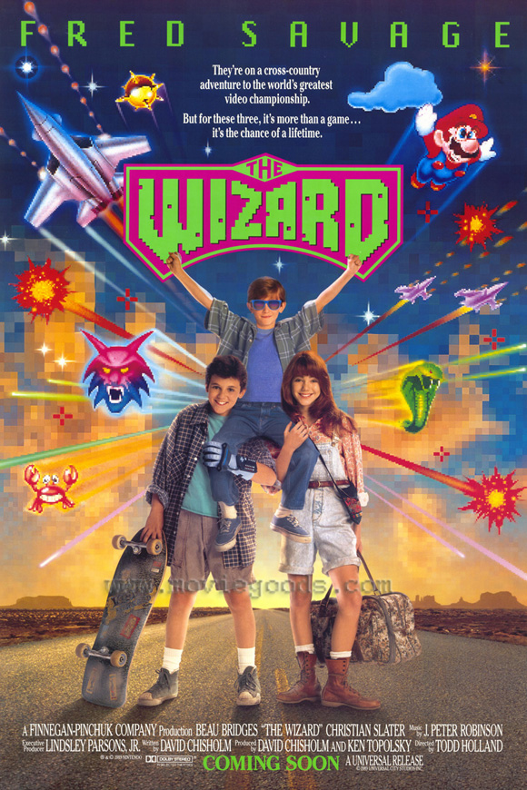
From mass appeal to film…
The first gaming generation (me!) is now in their 30s and 40s; thus games and consoles can be advertised as “legitimate entertainment…[and] desired objects of modernity” (1st ed.)
Perhaps nothing validates video games as mainstream entertainment with mass appeal than the number of films based on video game characters.

Slide 53

Why are so many video game films terrible?
Bad plot or no plot: some films are made from games with little to no plot (DOOM).
Others, in the search for a plot, deviate from the source game substantially until the film is not even really about the video game or its character at all.

Slide 54
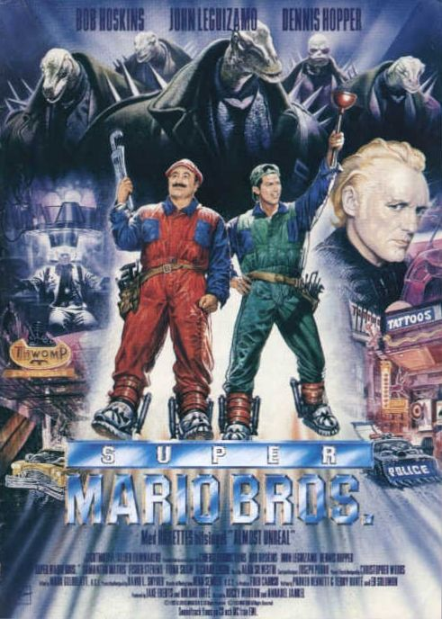
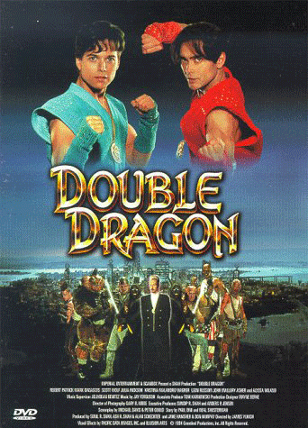

Slide 55
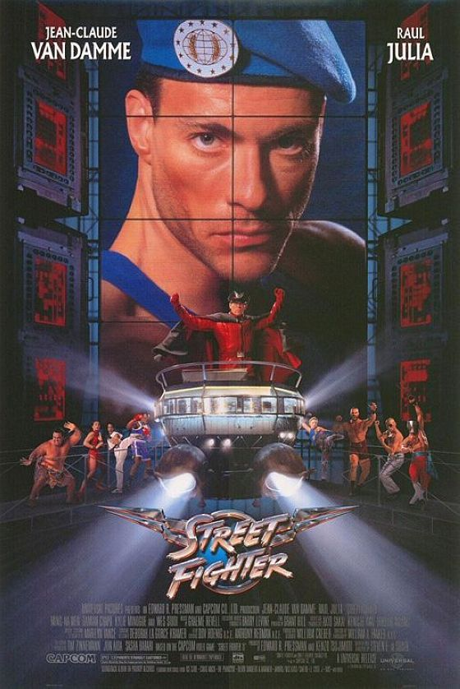
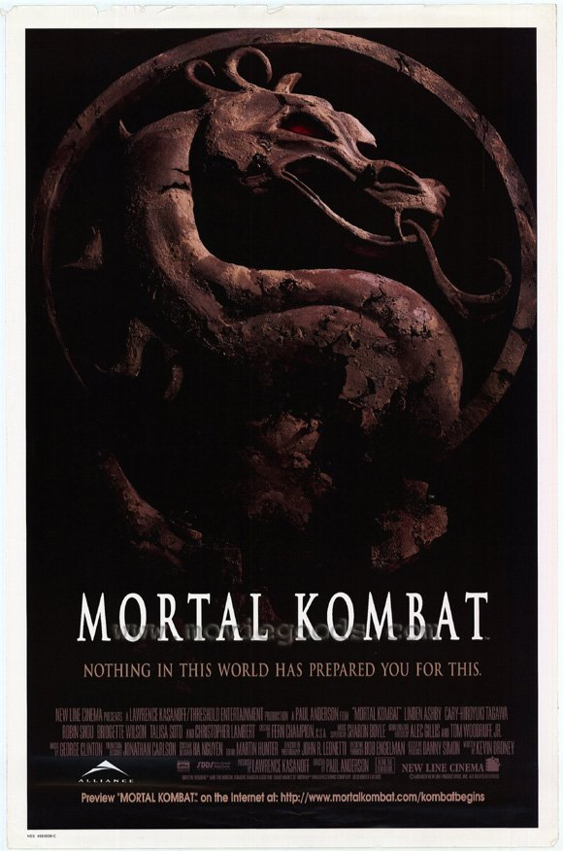

Slide 56



Slide 57



Slide 58



Slide 59
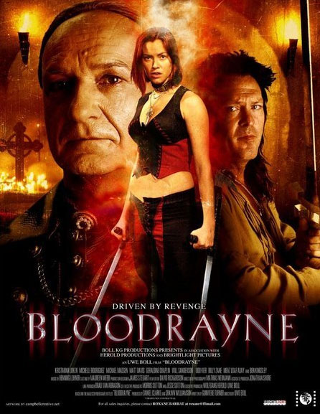
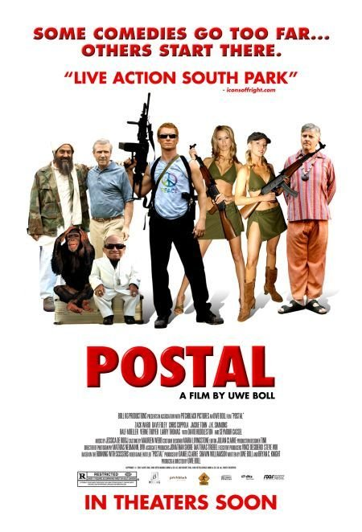

Slide 60



Slide 61
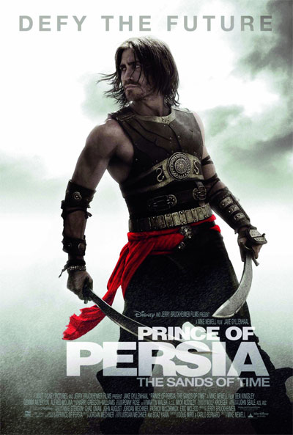
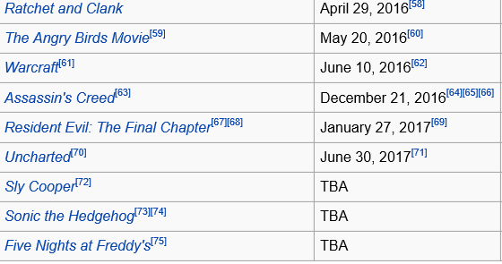
And it continues…

Slide 62
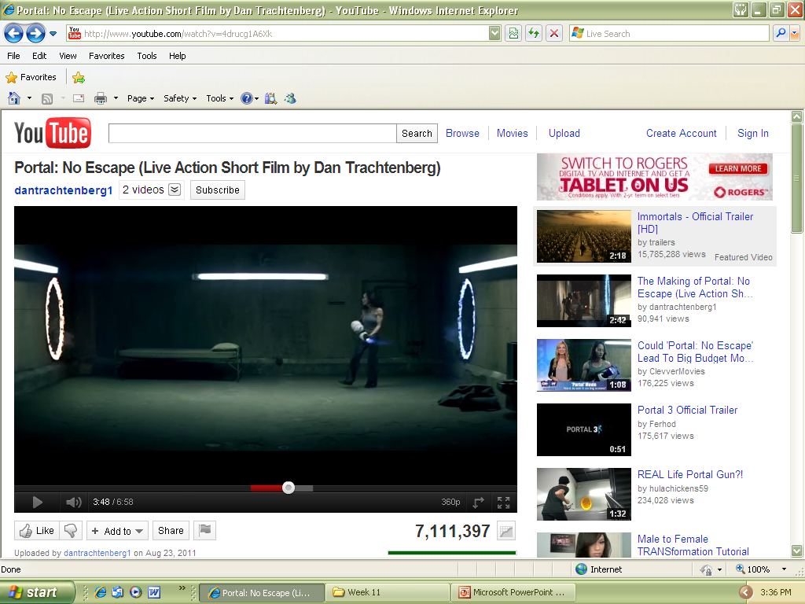
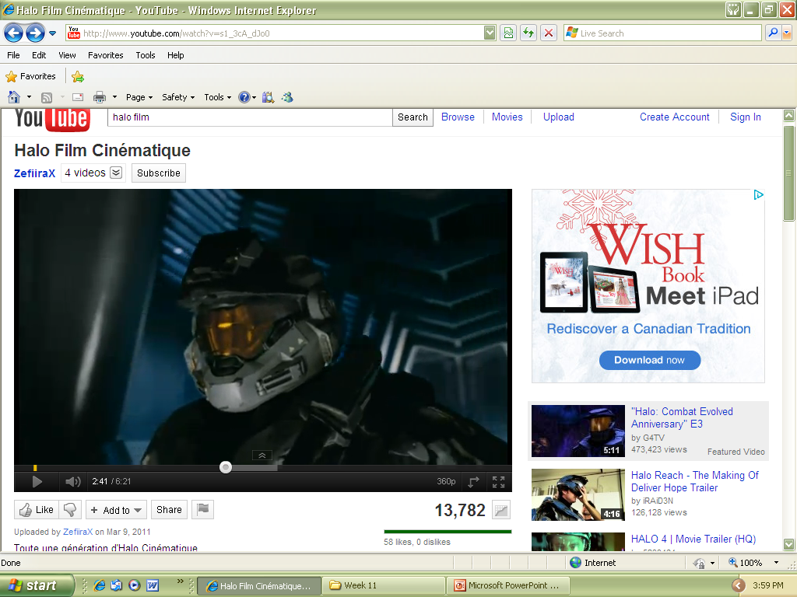
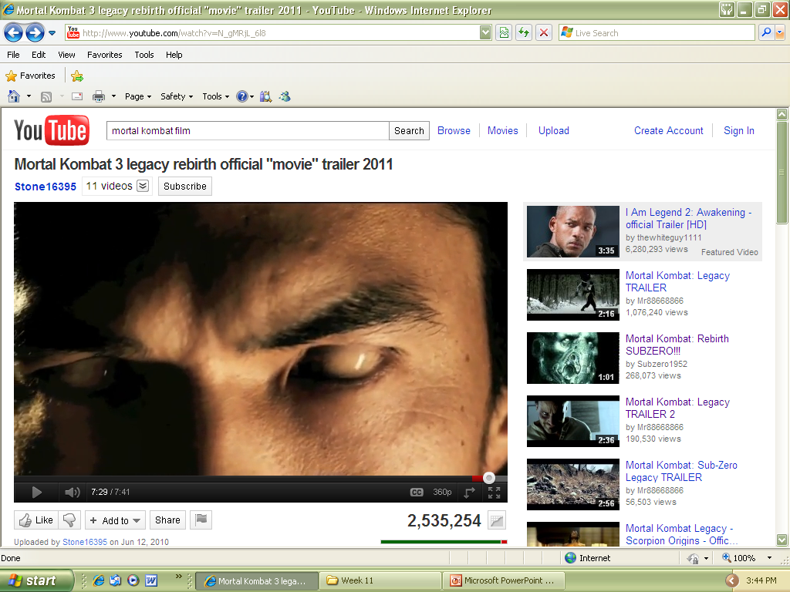
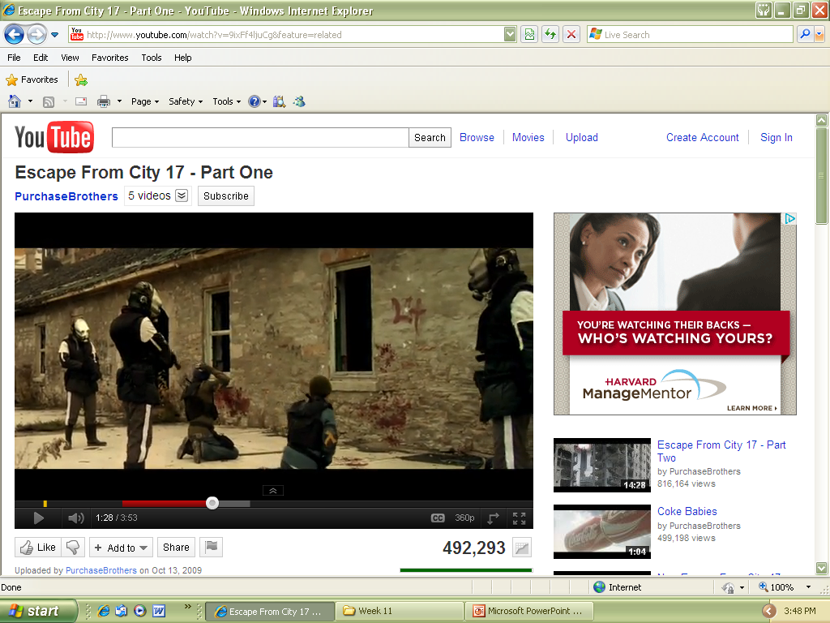
Halo
Portal
Exceptionally Cool Independent Short Films
Half-Life
Mortal Kombat

Slide 63
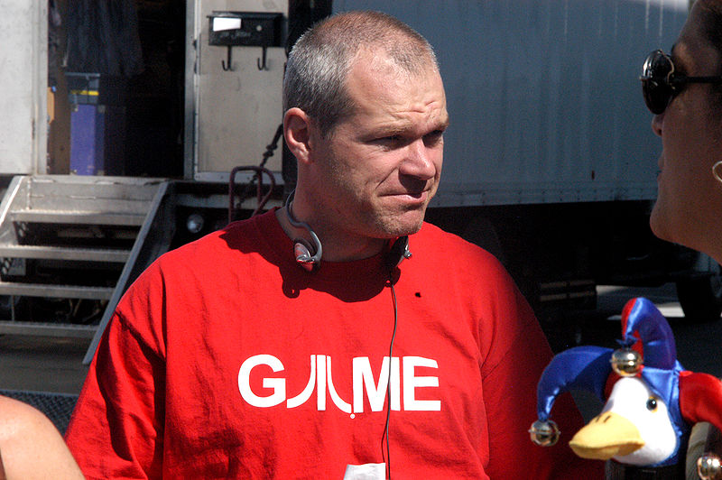
Who is Uwe Boll?

Slide 64

Uwe Boll is a German director, producer and screenwriter of films often adapted from video games.
Movies directed by Boll usually tank at the box office: House of the Dead (budget: $12 million) made $5.73 million, Alone in the Dark (budget: $20 million) made only $5.1 million, and BloodRayne (budget: $25 million) topped $2.42 million.
Acquires funding thanks to German tax laws that reward investments in film.
The law allows investors in German-owned films to write off 100% of their investment as a tax deduction; it also allows them to invest borrowed money and write off any fees associated with the loan.

Slide 65


Video Games:
“Player Culture and MetaCulture”

Slide 66


Defining “Gamers”
Video gaming culture (or “geek culture”) is certainly more mainstream than it used to be.
In the beginning games were made for a general (if not exclusive) audience—then they got specialized: MMOs, MOBAs, iphones…
Many people identify themselves as gamers, but what is a gamer?
Hard-core Vs Casual?
In the end, it’s all about self-perception: you can be a casual Halo player or a hardcore Bejeweled player.
A Gamer: someone who plays a wide variety of games

Slide 67

Game Communities: Formal and Informal
In the beginning: LAN Parties
Informal: A place to gather and create; A place to bask in shared cooperation
Formal: Dedicated members belong to clans/guilds, maintain websites, engage in detailed discussions, attend conventions, establish their own rules of play—essentially these players form their own mini-societies.

Slide 68

“Leeroy Jenkins!”
Character created by Ben Schultz in 2005 for World of Warcraft.
Famous for a (staged?) video depicting the character rushing head first into battle while his guild-mates plan a strategy outside of the room.
The guild, much to their annoyance, is drawn into the room and to their doom!
Leeroy Jenkins HD

Slide 69

Pop Culture Phenomenon
Gets a question on Jeopardy!
Mentioned on South Park WoW parody episode
Blizzard adds the attainable title of “Jenkins” to players who kill 50 of the famous dragon whelps from the video within 15 seconds.
In 2007, Toyota released an ad for the Toyota Tacoma parodying the Leeroy Jenkins video, and in particular the line "Let's do this!"
Leeroy Jenkins Toyota Commercial

Slide 70

“All Your Base Are Belong To us”
Game Zero Wing for the Sega Mega Drive
Famous for its horrible Japanese to English game text translation.
Sparked a mini-craze around the phrase “All your base are belong to us”
All Your Base Are Belong To Us (Higher Quality) - YouTube

Slide 71




There’s nothing new about video game catchphrases and memes

Slide 72


“Leet” or “1337”
Gaming can develop its own lingo.
Video game terms like “NOOB” or “PWN” have permeated the culture.
Various games and gaming genres have developed their own code-speak (ex: fragging, boss).
Leet—code which specifies alternate ways of writing English words.

Slide 73

“Poaching”
Any activity where fans creatively reuse content from other media.
In video games the most popular are…
Writing walkthroughs/Wikis
Creative writing that expands the gaming universe (fan fiction)
Comic strips, art, or music

Slide 74




Slide 75


Slide 76


“Machinima”
Movies made with video game content through careful edits and other film techniques.
Feature voice-over acting with original scripts.
Why Are We Here? - Episode 1 - Red vs. Blue Season 1 - YouTube
YouTube - New Mario Bros. Movie Trailer

Slide 77

Independent Web Sitcoms

Slide 78




Fashion and Accessories: Thinkgeek, jinx.com, HMV, hottopic

Slide 79


Slide 80



Slide 81







Cosplay.com

Slide 82





Action Figures

Slide 83

Resident Evil 4 official “Chainsaw Controller.” Manufactured by Nuby Tech. Suggested retail: $49.99

Slide 84



“Frostmourne” replica sword from World of Warcraft.
Sells for $379 US.

Slide 85

GOW 3: Epic Edition. Is all this worth 150bucks to you? To each his/her own I guess…

Slide 86

Batman: Arkham City Collector’s Edition: $130

Slide 87


Body Modification

Slide 88


Body Modification

Slide 89


Amateur Internet Content: We Play and “PewDiePie” AKA: Felix Kjellberg
Huge market on Youtube of amateur content.
People play video games and make “funny” comments overtop.
“PewDiePie”: Most subscribed to channel on YT
Annual income $4 million/year
39 million subscribers—most of all time
10 billion views—most viewed channel of all time
Let's Talk About Money

Slide 90







Internet Content: IGN, Reviews, Journalism, Networks, Streaming
The Escapist : Video Galleries : Zero Punctuation

Slide 91


Professional Gaming/Gamers
Parallels exist with physical athletes.
Both groups…
Train by playing a game
Find corporate sponsorship
Enter gaming tournaments
Hopefully win prizes and recognition.
Very few people can make a living at this “sport.”

Slide 92



“Twitch TV”
Live streaming platform designed for real-time coverage of electronic sports
By February 2014, it was considered the fourth largest source of peak Internet traffic in the United States
Acquired by Amazon.com for $970 million in Sept 2014.

Slide 93


“Ksharp”
Kyle ‘Ksharp’ Miller (born August 21, 1984) is an electronic sports player who plays Counter-Strike 1.6 and moved to Counter-Strike Source. His success has allowed him to defer attending college while earning a living as a gamer. Miller has since retired from professional Counter-Strike” (Wikipedia)

Slide 94


“Fatal1ty”
Johnathan Wendel
Considered the world's first prominent and accomplished professional gamer.
Has won approximately $500,000 US in cash and prizes from professional competitions.
Retired, but continues to make money through licensing his brand.
Fatal1ty - Key Gaming Skills - YouTube

Slide 95


Slide 96

In Korea, professional Starcraft players are treated like rock stars.
Two major TV channels run tournaments
Lim Yo-Hwan (AKA: BoxeR): fan club with 1,000,000 members. Sells a DVD of his greatest moments.
Annual earnings exceed $400,000 US; endorsement contracts bring in an additional $90,000 per year
500 televised wins

Slide 97

Virtual Economies, Real-Money Trading, and Goldfarming
Video Game sweatshops: building and selling of accounts; workers (“gold farmers”) paid very little money.
Online game merchandise industry: practice of paying real money for accounts or for in-game virtual money (also called “the secondary market”.)
Discouraged by game companies (ie: Blizzard)
10 hour shifts/ 30 cents an hour/ food and beds provided/8 people per room.

Slide 98



YouTube - BBC Gold Farming OMFG
While their revenues are declining IGE.com once stated that their revenues exceeded 880 millions dollars a year.

Slide 99

What Does It All Mean?
You may consider yourselves first and foremost game designers, but the simple truth is you are also:
An artist
A brand (so brand yourself or BE branded)
Part of a youth culture that feels ownership of your property and entitlement to criticizing or modifying your property
Part of a culture machine that will commodify (for good and bad) all of your efforts with or without your consent
Thus, in this industry you have many important decisions regarding your brand/intellectual property that extend FAR beyond the code you program and what gamers play on a screen

